Slide 1
CS1070: Taming Big Data
Numpy, Pandas and DataFrames

Slide 2
Logistics
Homework 1 due on Tuesday

Slide 3
Review
TODO: Boolean logic review, control structure review

Slide 4
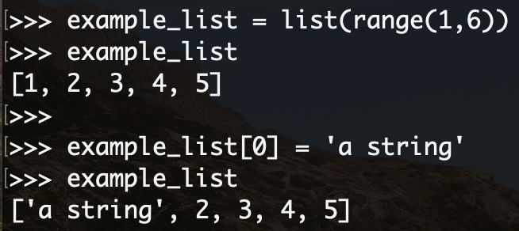
Lists vs. Dictionaries
A list is a mutable, ordered collection that can contain any type of data

Slide 5
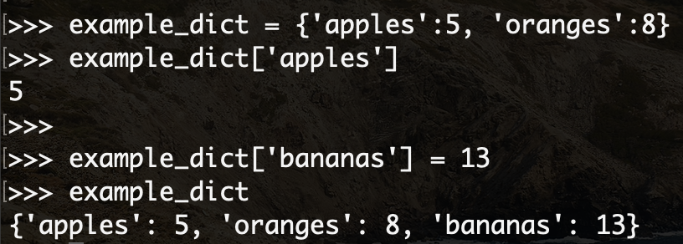
Lists vs. Dictionaries
A dictionary is an unordered collection of key:value pairs
Instead of looking up a value by an index, you look them up by a key

Slide 6
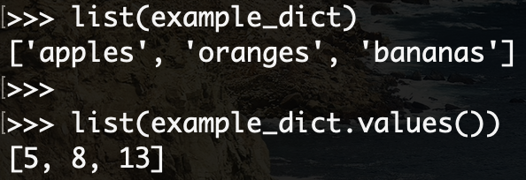
Lists vs. Dictionaries
A dictionary can be converted to a list
list(dictionary_object): returns a list of keys
list(dictionary_object.values())

Slide 7
Numpy
Core library for scientific computing
Provides a really good multi-dimensional array object + tools for working with that array
What’s an array?
A grid of values
All of the same type
Number of dimensions is the rank of the array
The shape of an array is a tuple of integers giving the size of the array along each dimension

Slide 9
Why not lists?
Python lists can store the same information, but numpy is superior in terms of:
Size: take up less space in memory
Performance: implementation is faster than lists
Functionality: NumPy has built in, optimized functions such as linear algebra operations

Slide 10
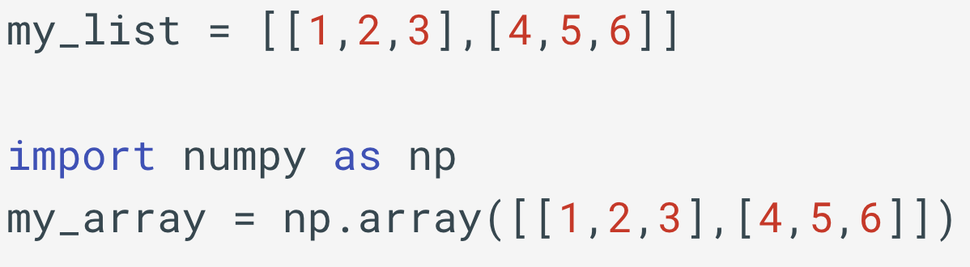
Creating Numpy Arrays

Slide 11
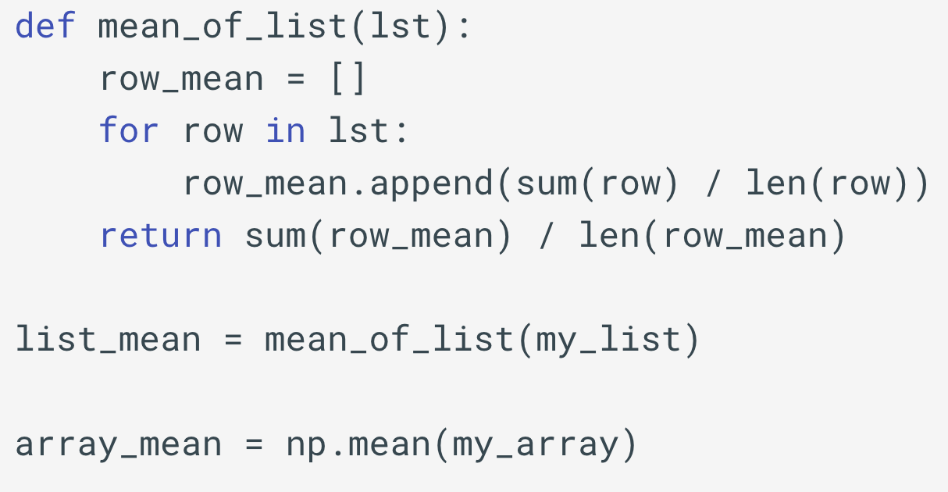
Computing the Mean w/ Lists vs Arrays

Slide 12
NumPy Documentation
https://docs.scipy.org/doc/numpy/reference/
https://s3.amazonaws.com/assets.datacamp.com/blog_assets/Numpy_Python_Cheat_Sheet.pdf
The big things you’ll need for this class:
How to create arrays
How to index into arrays
How to compute statistics of arrays (e.g., mean, median, standard deviation)

Slide 13
Pandas
Pandas is an open source library that provides high-performance data structures and data analysis tools for Python
Our text calls is ‘the pre-eminent data-wrangling tool in Python’
What does that actually mean?
Excel spreadsheet / Google Sheets for Python

Slide 14
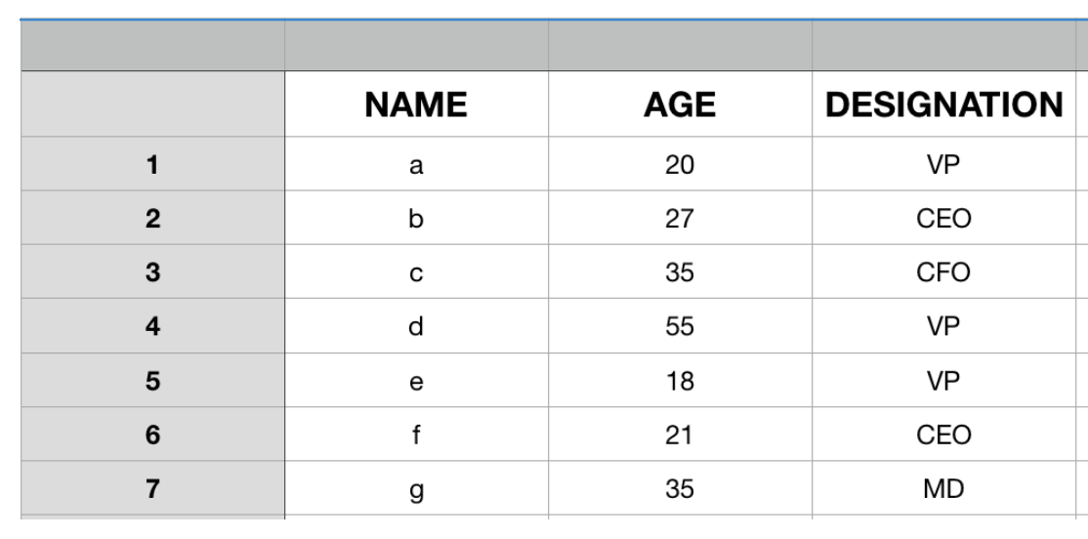
Pandas DataFrame
2D labeled data structure with rows and columns
Each row represents one individual or sample
Columns can be different types

Slide 15
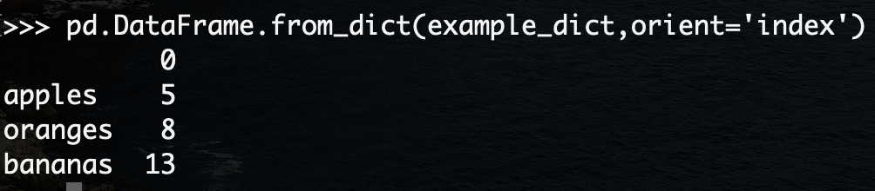
Pandas DataFrame
Can be created from a dictionary, or from Excel spreahsheets, CSVs, MySQL databases, etc.

Slide 16
Pandas DataFrame
Download ‘credit_card_data.xls’ from course website
We are going to complete Exercise 2 from the text (page 14) together to see how to load an excel sheet into a pandas DataFrame

Slide 17
Different Types of Data Science Problems
Data wrangling is one of the most significant things a data scientist does:
Figuring out how to get data and from where
Examining the data
Making sure the data is correct and complete
Joining it with other related data
Once you have the data, you’ll likely want to do predictive modeling
Using a mathematical model to learn the relationships within the data in order to make accurate predictions when new data comes in

Slide 18
Predictive Modeling
Data is organized in tabular format (as in a DataFrame), with independent and dependent variables
If you want to predict the price of a house based on features like the size of the house and number of bedrooms, the price of the house is the dependent variable, and the size and number of bedrooms are independent variables.
Independent variables – features
Dependent variables – response variable or target variable

Slide 19
Types of Predictive Modeling
Regression problem: predict the precise numerical value of the dependent variable on a continuous scale based on the independent variables that you observe
For example, given a house size and number of bedrooms, predict the exact dollar amount that house will sell for
Classification problem: make a qualitative prediction of the dependent variable
For example, answer yes or no to the question “Will this house go on sale within the next five years?”

Slide 20
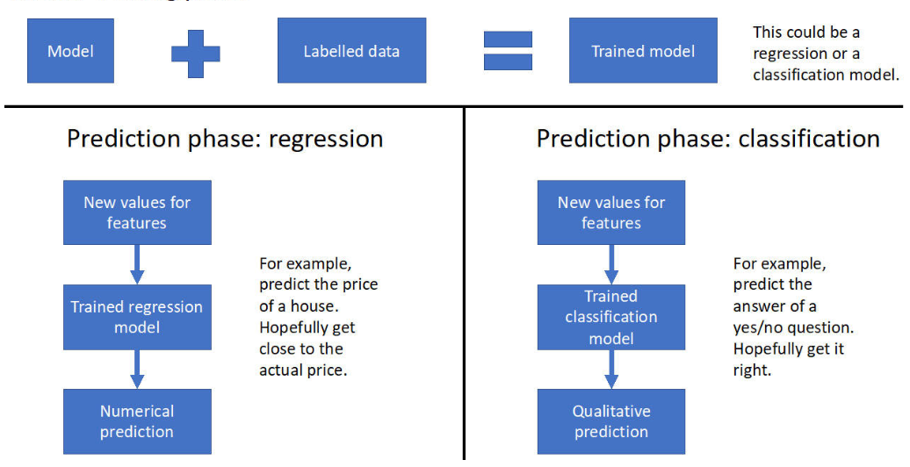

Slide 21
Supervised vs. Unsupervised Learning
Right now we’re treating the “model training” as a black box
Two types of model training (or “learning”):
Supervised
Relies on you having labels for your data
“Supervision” of the target variable by the known features
Unsupervised
More open questions that try to determine the underlying structure in a dataset that does not necessarily have labels

Slide 22
Pandas DataFrame
Okay – going back to that credit_card_data that you downloaded and loaded into a DataFrame…
Let’s image the following situation:
We are working for a credit card company
The have a dataset that includes some demographics and recent financial information for a sample of ~30k account holders
The data is organized at a credit account level – one row for each account
Rows are labeled by whether the account holder defaulted
Task: develop a predictive model for whether an unlabeled account will default in the next month.

Slide 23
Ideas?

Slide 24
Step 1) Data Exploration
Before we can get to any actual modeling, we need to make sure we understand the data that we have
Useful questions to answer in data exploration:
How many columns are there in the data?
How many rows (samples)?
What kind of features are there? Which are categorical and which are numerical?
What does the data in these features look like? (e.g., what are the statistics of it?)
Is there any missing data?
Notes:
Do Exercise 3

